Slide 1

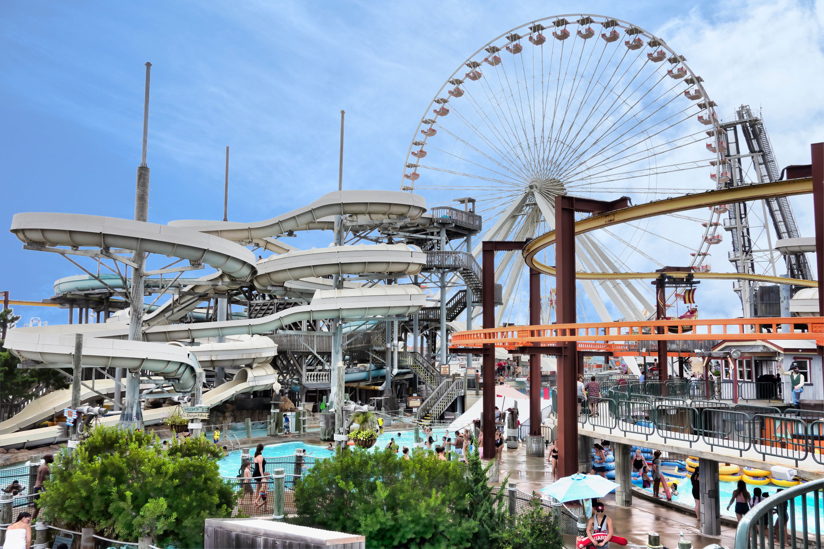


Keansburg
Park
Home
About
Service
Gallery
Book now
WaterPark Presentation
Keansburg
Park
Start Presentation

Slide 2

GROUP 7
PROJECT GROUP 7
Group members:
Le Nhat Huy
Le Minh Duc
Nhat Hoang
Nguyen Khanh
Minh Khoi

Slide 3
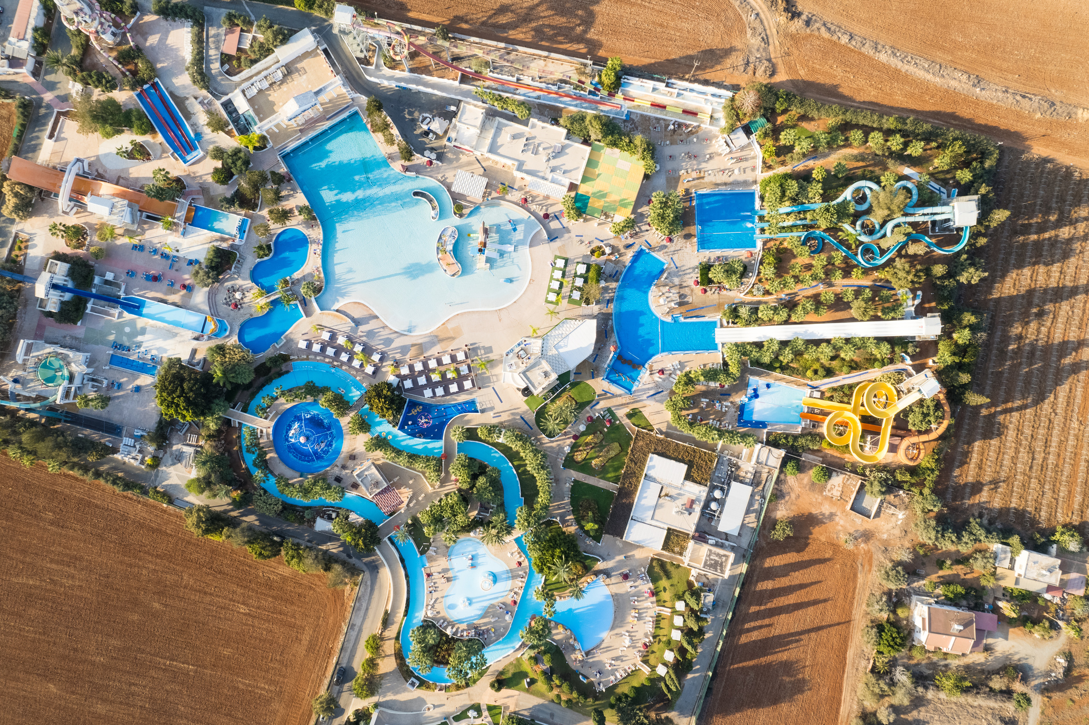

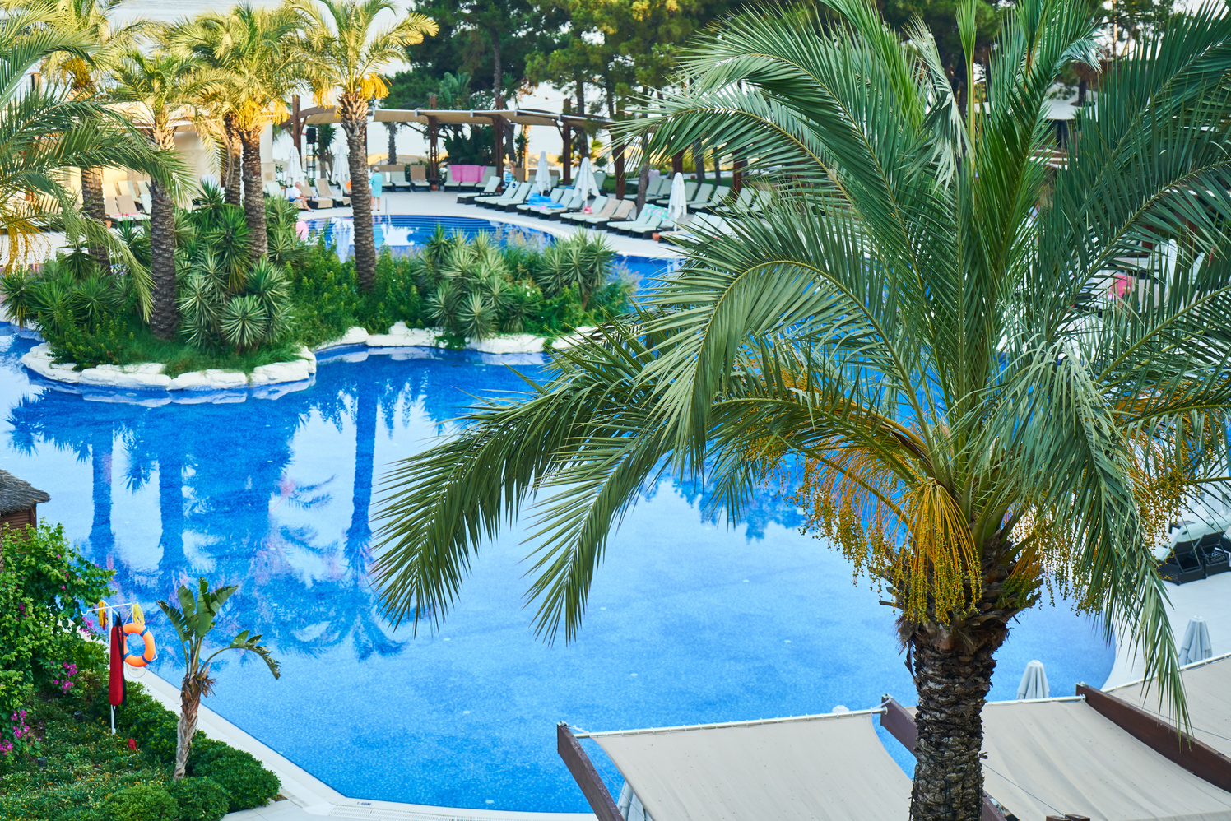
Keansburg
Park
Book now
Welcome to
Keansburg Park
99%
Some informations about Keansburg Park
Keansburg Park is now prime focus of the the city and nation. It is made by Gottlieb groups of companies. The development of this park took 5 years to get their desired finished product. It has become nation pride now. The area of theme park is about 45 acre land
Of children are safe & supervised by staff
More Information
www.reallygreatsite.com

Slide 4

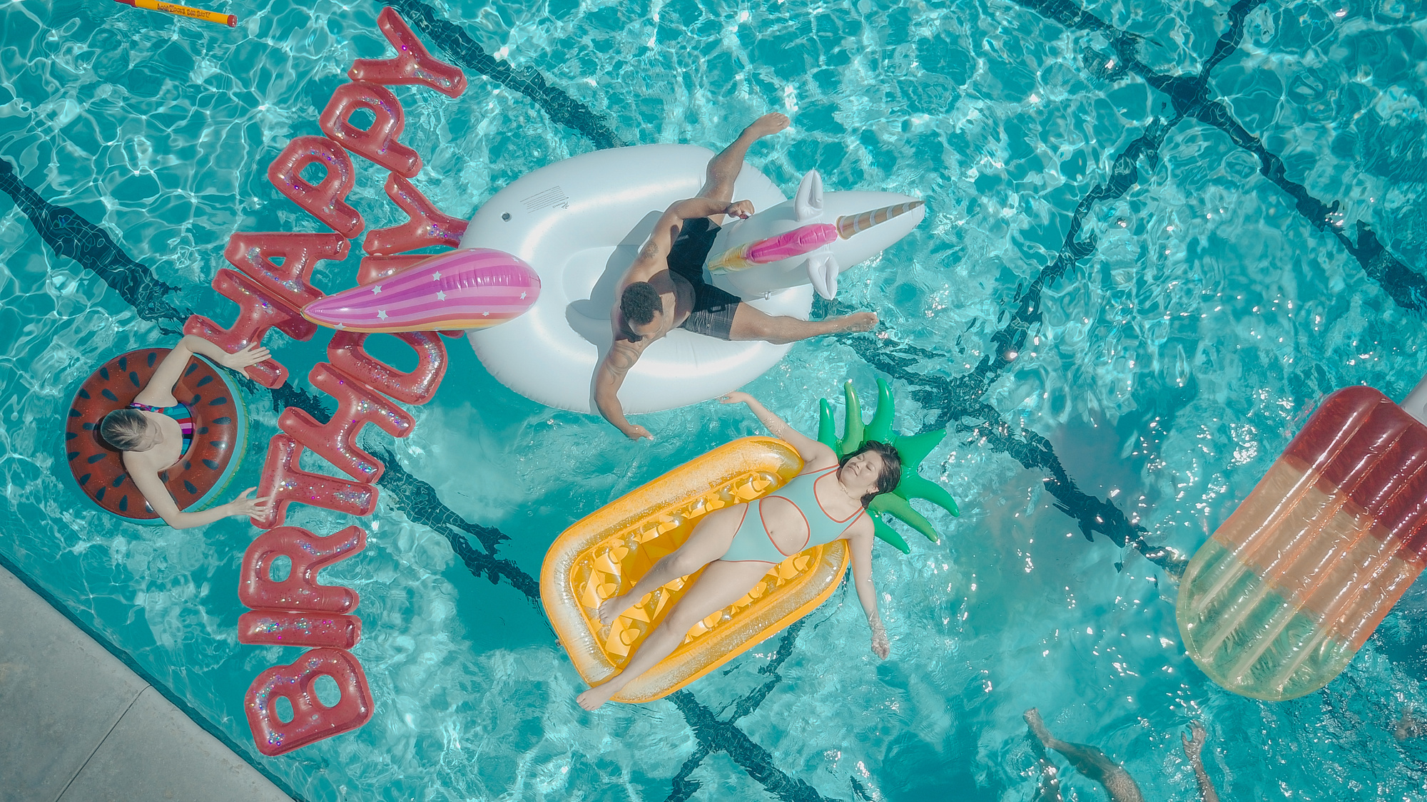
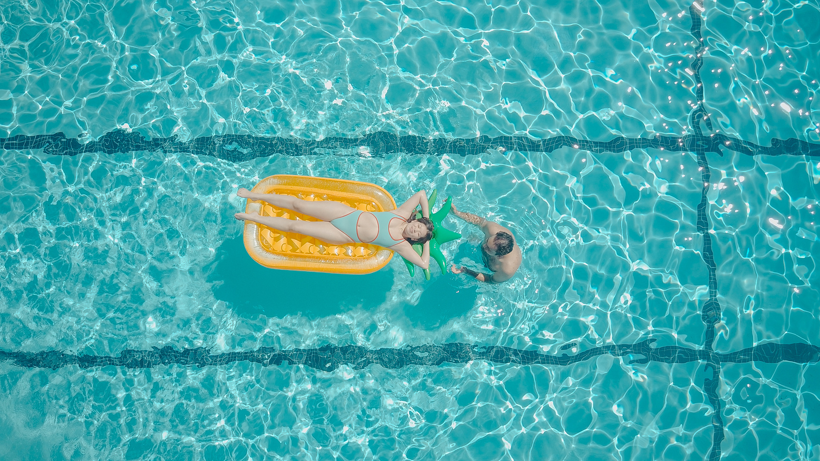
Keansburg
Park
Book now
Our WaterPark
Get the biggest discount!
Tour Packages
Basic Package
Family Package
$60,90
$260,90
Get Small Gazebo
All access to waterpark
Free Soft Drink
Get Two Gazebo
Get One Locker
Free Soft Drinks
Free Towel
Get Four Lockers
Free Four Towels
Book now
Book now
www.reallygreatsite.com

Slide 5
Keansburg
Park
Book now
Create an app- single page and website that meets the requirements of the article
REQUIREMENTS
Health Services
Developed using HTML5, JSON, ReactJS, JavaScript. The website will work fine in all browsers including Edge, Chrome, Mozilla Firefox, Safari.

Slide 6
Techonologies:
HTML
CSS
JavaScript
Bootstrap
ReactJS
Node JS
PHP
MySQL

Slide 7
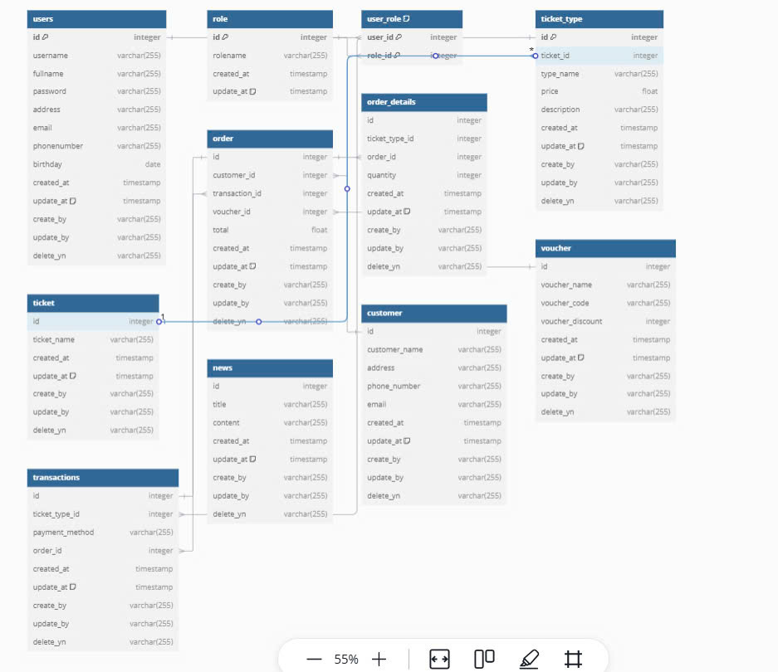

Slide 8
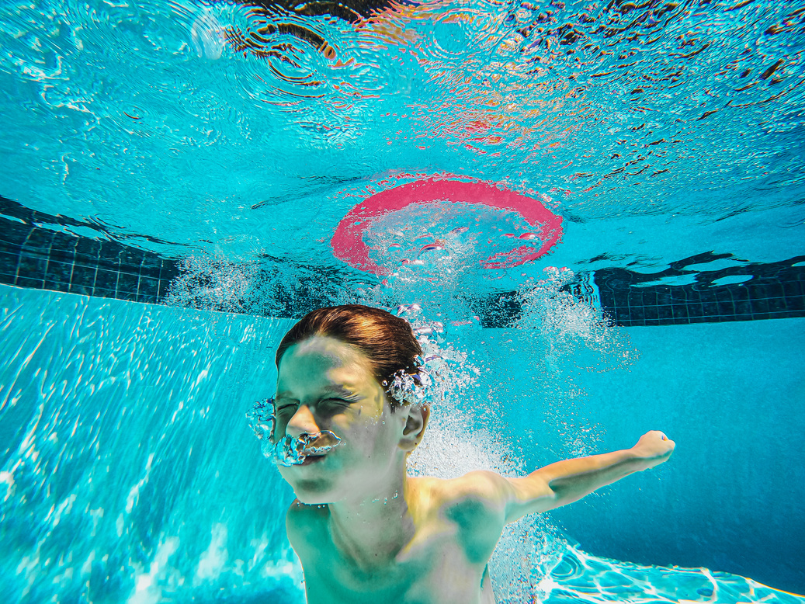

Keansburg
Park
Book now
WaterPark Presentation
Thank For
Your Attention
End Presentation
www.reallygreatsite.com

